Slide 1


The Data Science Specialists.

Slide 2

Unlock the potential of
Data Science with us

Slide 3
Data Science as
connecting piece…
www.eoda.de

Slide 4





Big Data
Competence in IT and software development
Methodical know-how of
mathematics and statistics
Understanding of business processes
Big Business
www.eoda.de

Slide 5
… and success factor in many
fields of application
www.eoda.de

Slide 6






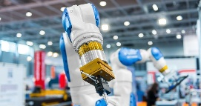




Data Science
Retail
Energy
Finance
Industry
Pharma
Tourism
Chemistry
Public Ad-ministration
Logistics
Marketing
Market Research

Slide 7
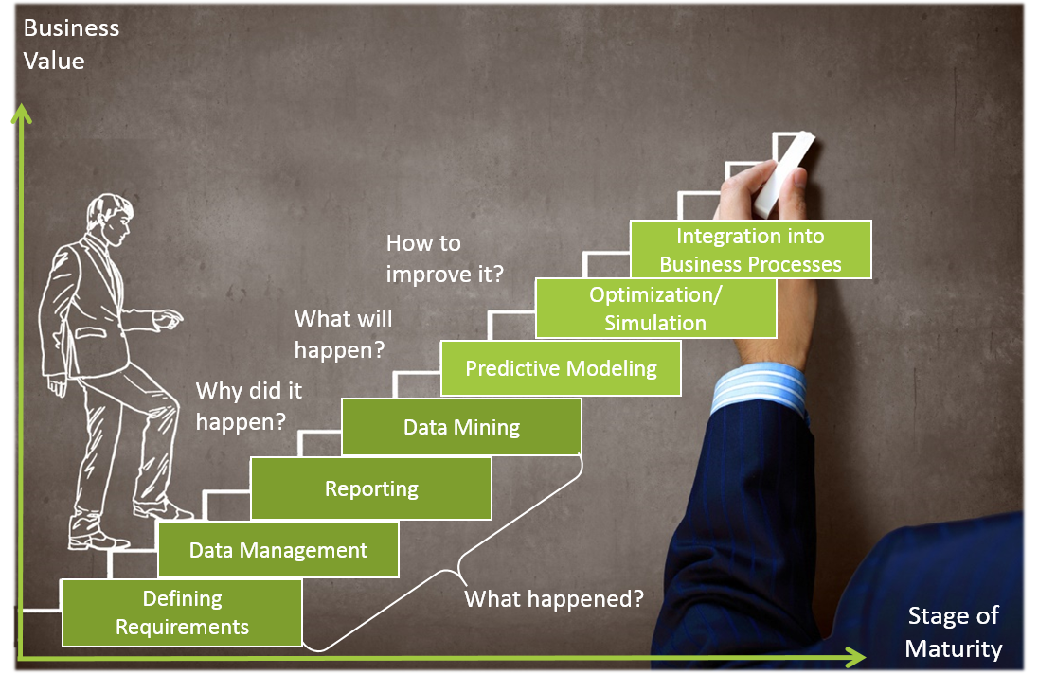
Our Approach
We transform data into measurable value
We increase your analytical maturity
www.eoda.de

Slide 8
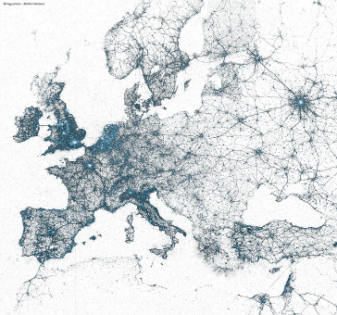



We are counting on R
R is one of the best solutions for analyzing and visualizing data, for data mining and predictive analytics.
Europe and New York City – The Arteries of the World in Tweets.
A visualization with 20 lines of R code.
We are one of the pioneers in the professional application of R
www.eoda.de

Slide 9


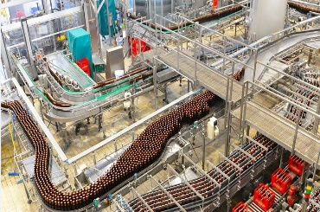

For every topic the right offer
Generating new knowledge with eoda | survey
The holistic service for data collection
Increasing data quality with eoda | consolidate
Making data usable – gaining knowledge
Reliable sales forecast with eoda | sales forecast
Increase your product availability and customer satisfaction
Know your customers with eoda | customer analysis
Understand your customers‘ needs and increase your sales
www.eoda.de

Slide 10




For every topic the right offer
Increasing reliability with eoda | predictive maintenance
The comprehensive offer for predictive maintenance
Optimize your quality management with eoda | quality
Intelligent process monitoring as driver of success
Identifying risks early on with eoda | assessRisk
Risk analysis as basis for decisions
Use existing potentials with eoda | optimize
Always find the best alternative for your company
www.eoda.de

Slide 11



Our portfolio
Data Science Consulting
Comprehensive consulting from data acquisition to analysis to recommendations for action
Analytic Services
Efficient solutions for your individual data mining and predictive analytics needs
Training
R Academy: Practice-oriented and comprehensive training for data science with R
www.eoda.de

Slide 12



Our portfolio
R Support
Professional data science support for your analysis processes
translate2R
Automatic translation from Base SAS® and IBM® SPSS syntax to R
operateR
The framework for the professional application of R
www.eoda.de

Slide 13
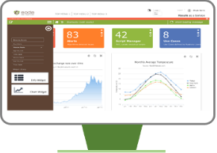





Our portfolio
Results as a Service
With Results as a Service you can integrate data science fast and sustainably
into your business processes
Data Science for Business Processes
Data
Various Data Sources
Models
Statistical
Models
Collaboration
Workflow and Cooperation
Results
Delivering Analysis Results
Integration
Operationalization into Business Processes
www.eoda.de

Slide 14






Our References
Partners that trust in us
Industry and Energy
Market research, Consulting, Media
Saint Gobain | Trumpf | BASF | marburg | SMA | Thales | Sika | Pioneer | EnBW | OBI Group | Bayer | SCA | 50Hertz | Siemens | Senvion | Nordex
AVISPADOR | CBRE |(r)evolution | HNA |
Kleffmann Group | techconsult | Experton Group | Infratest dimap | Pilot | The Business Target Group | Deutscher Wetterdienst | FiBL | RC-Research & Consulting | BearingPoint
Financial Services
Information technology
KKH Allianz | DGUV | Belfius | CQuadrat | easyCredit | SWIFT | VR Bank
INFORM | RedGroup | Atos | eConnexAG | Cluster Reply | TripWire Solutions | Limón
Universities
Civil Service and Health Care
Philipps University | Leibniz University | Merz Academy | INCHER Kassel | University of Heidelberg | Helmholtz Institut | CESR | University of Rostock | University of Kassel | University of Bonn | University of Magdeburg | University of Lübeck |
TU Dresden | University of Paderborn | Justus-Liebig University Gießen | University of Regensburg
Bundesamt für Bauwesen und Raumordnung | Bundesinstitut für Bau-, Stadt- und Raumforschung | Stadt Wuppertal | Stadt Kassel | Charité |
Klinik für Tumorbiologie

Slide 15







Partners we trust
www.eoda.de

Slide 16
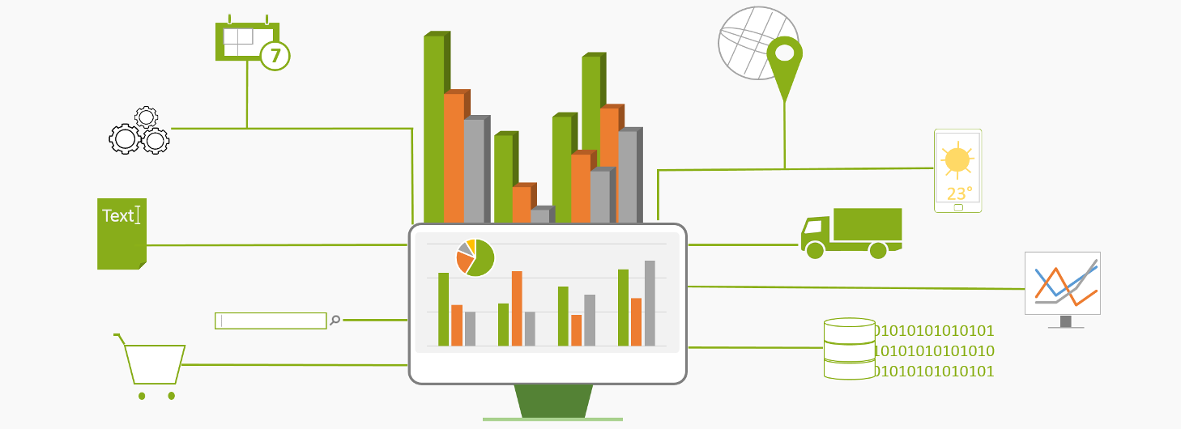
”Whatever it is producing, an organisation is most of all a factory of estimations and decisions.“ Daniel Kahneman

Slide 17





eoda GmbH
Universitätsplatz 12
34127 Kassel - Germany
www.eoda.de/en
info@eoda.de
+49 561 202724-40
@eodaGmbH
blog.eoda.de
@eodaGmbH
@eodaGmbH

